Slide 1

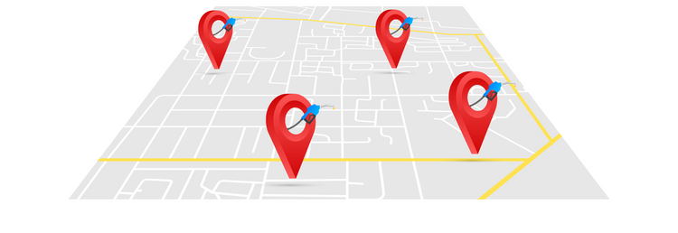


Fuel Finder
Data472 - TEAM Group
Hua, Hussain, Panli, Swathy

Slide 2
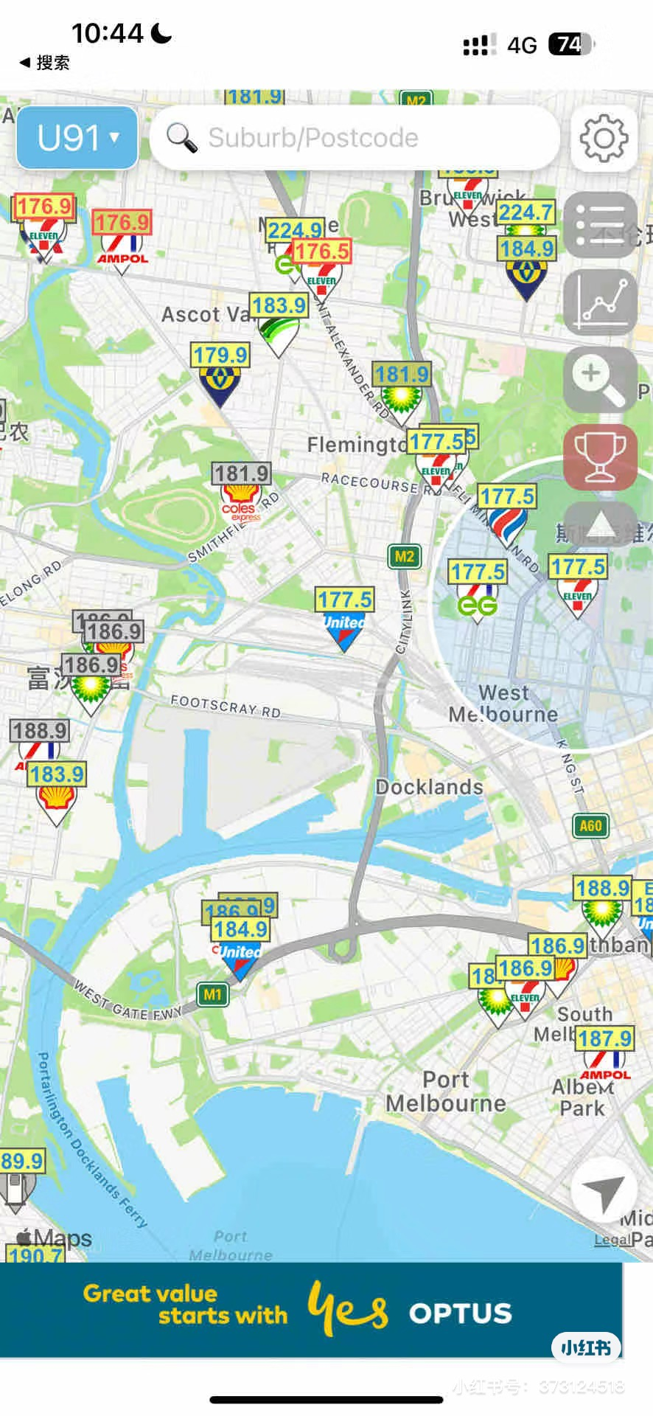
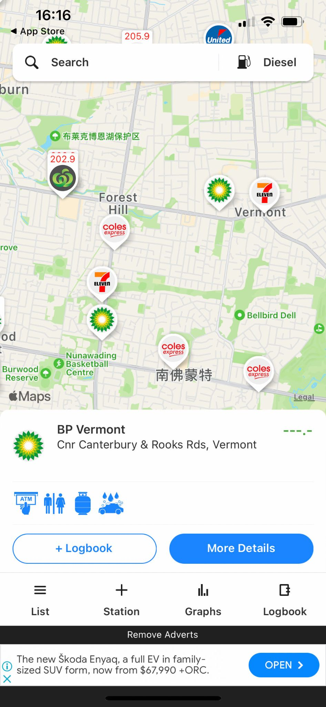
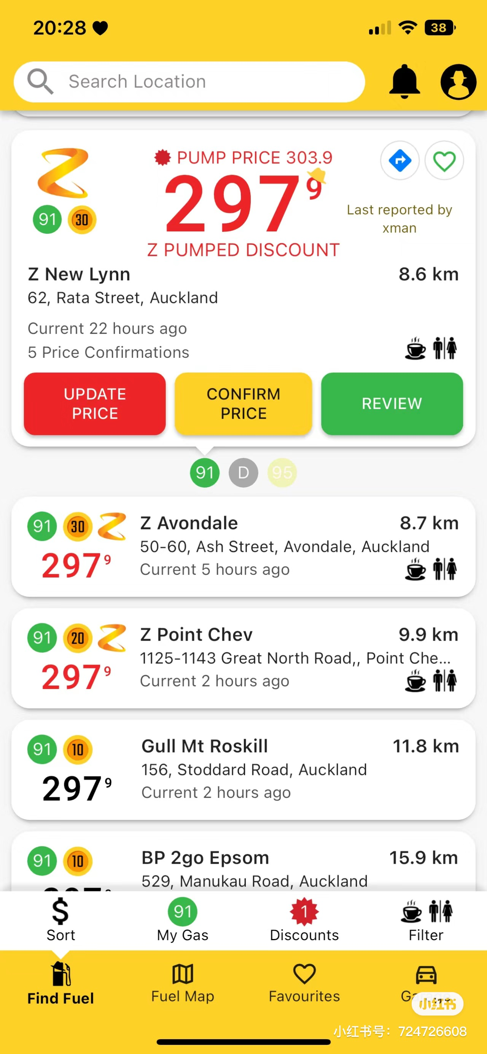
Introduction
Similar Product
Search for Gas Stations and Fuel Prices Within a 5 km Radius Based on User's Current Location
Location
Service
Map/List
Screen
Fuel Check in AU
Helping find the cheapest gas nearby
In-time
Price
Smart
Algorism
Gaspy in NZ
List the Fuel Price
Manual Search
No Map Service

Slide 3
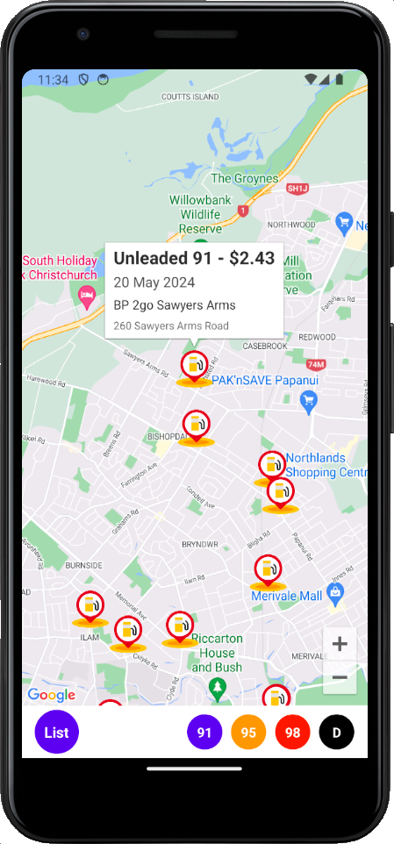
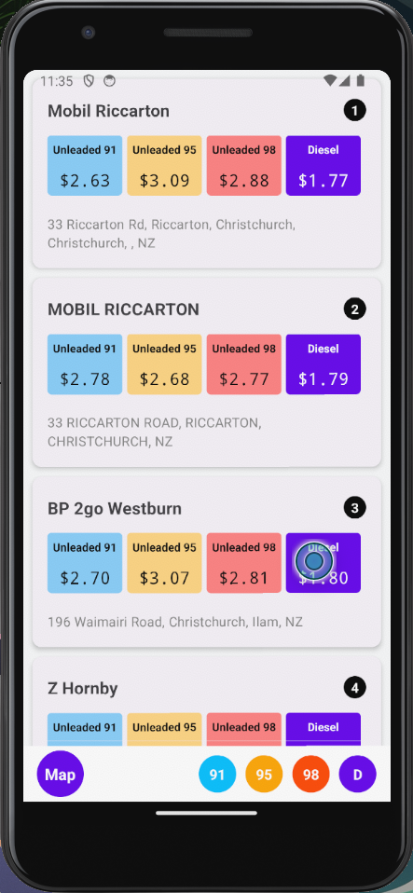
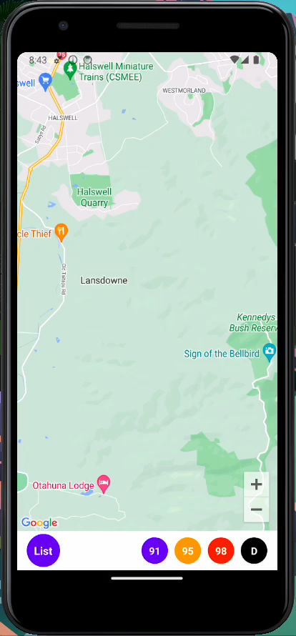
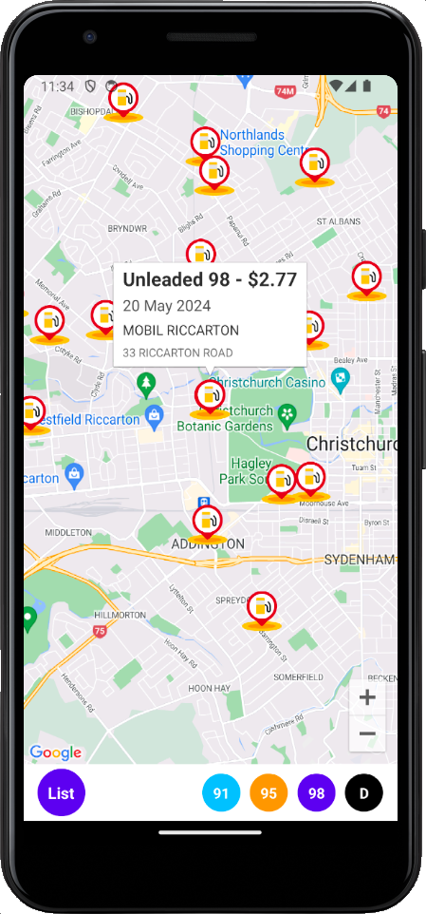
Current Product

Slide 4
How do we achieve this?

Slide 5
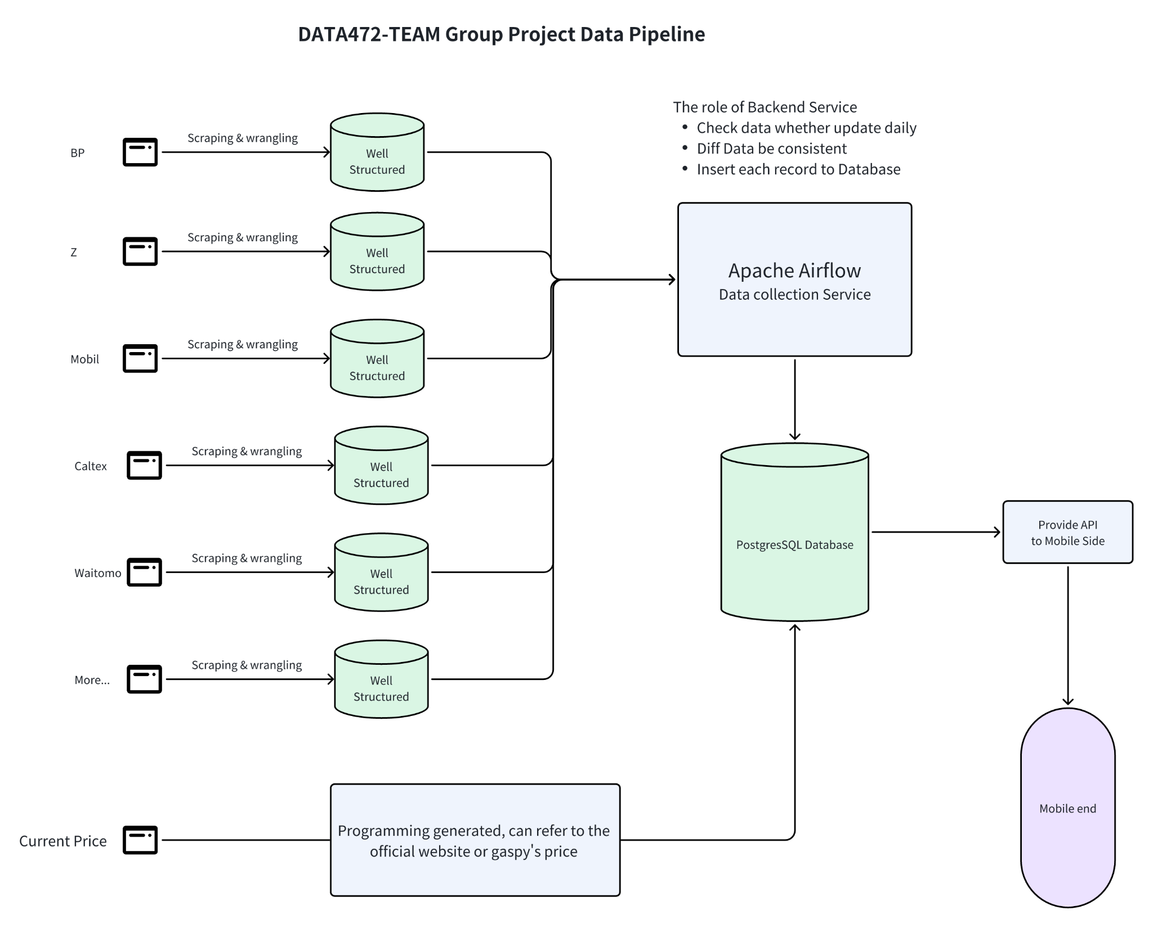
Data Pipline
Data Collection
Relational Database
Daily Updated
API

Slide 6
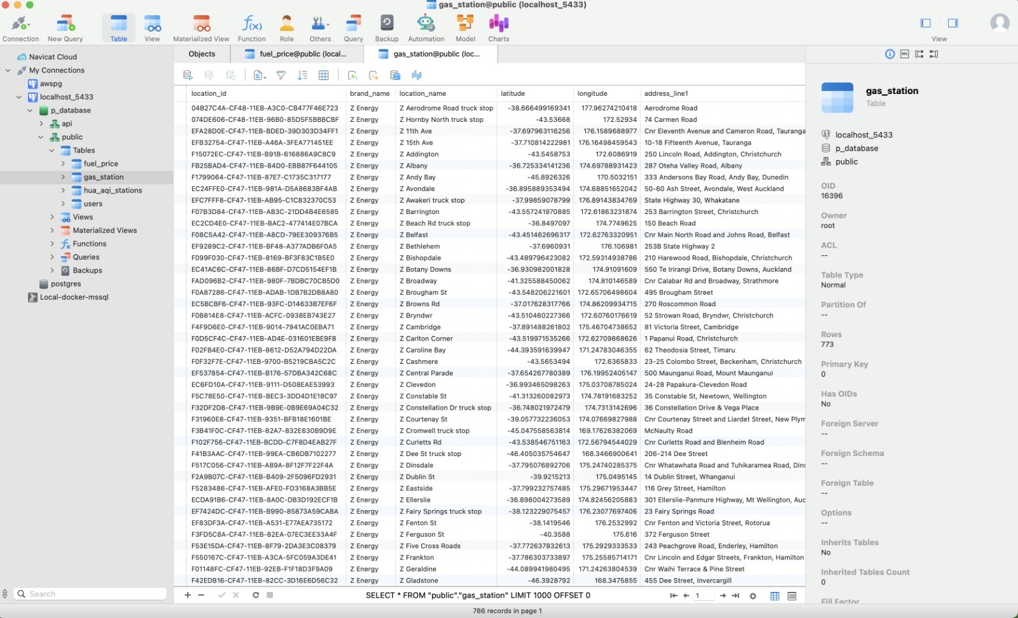

Data Pipline
Gas Station
Fuel Price
Data Collection
Relational Database
Daily Updated
API

Slide 7
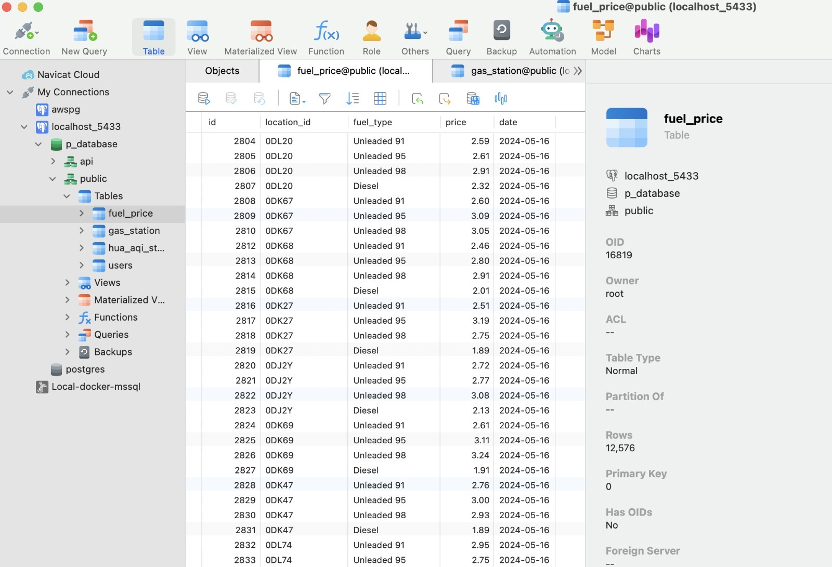
Data Pipline
Gas Station
Fuel Price
Data Collection
Relational Database
Daily Updated
API

Slide 8
Data Pipline
Data Collection
gas_station | gas_station
PK | gas_station_id
 | name
 | latitude
 | longitude
 | address
 | brand_id
gas_price | gas_price
PK | gas_price_id
FK | gas_station_id
 | price
 | fuel_type_id
 | date
brand | brand
PK | brand_id
 | brand_name
Relational Database
fuel_type | fuel_type
PK | fuel_type_id
 | fuel_type_name
Daily Updated
API

Slide 9
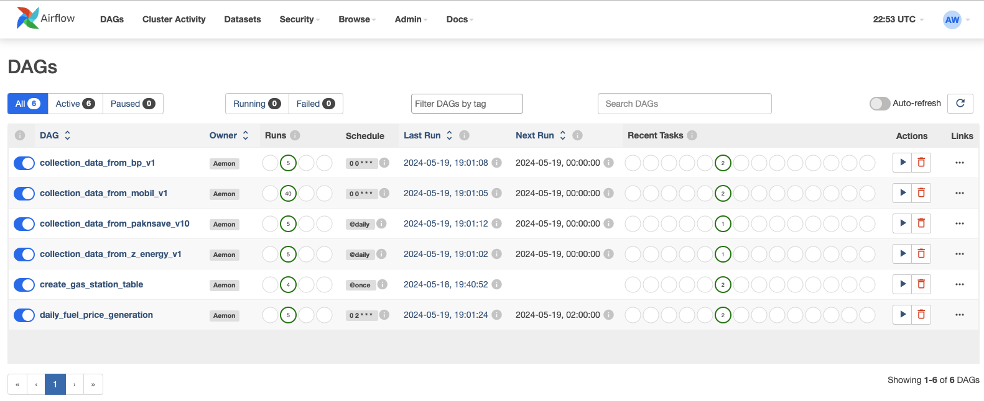
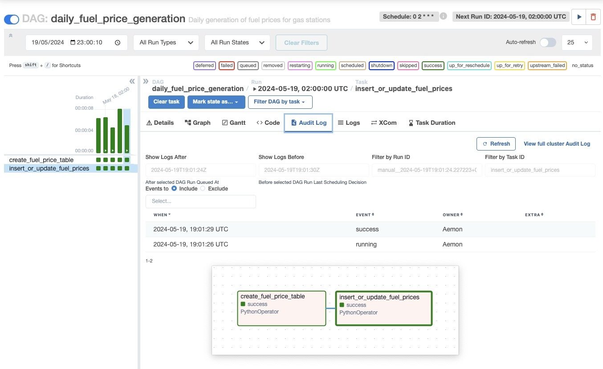
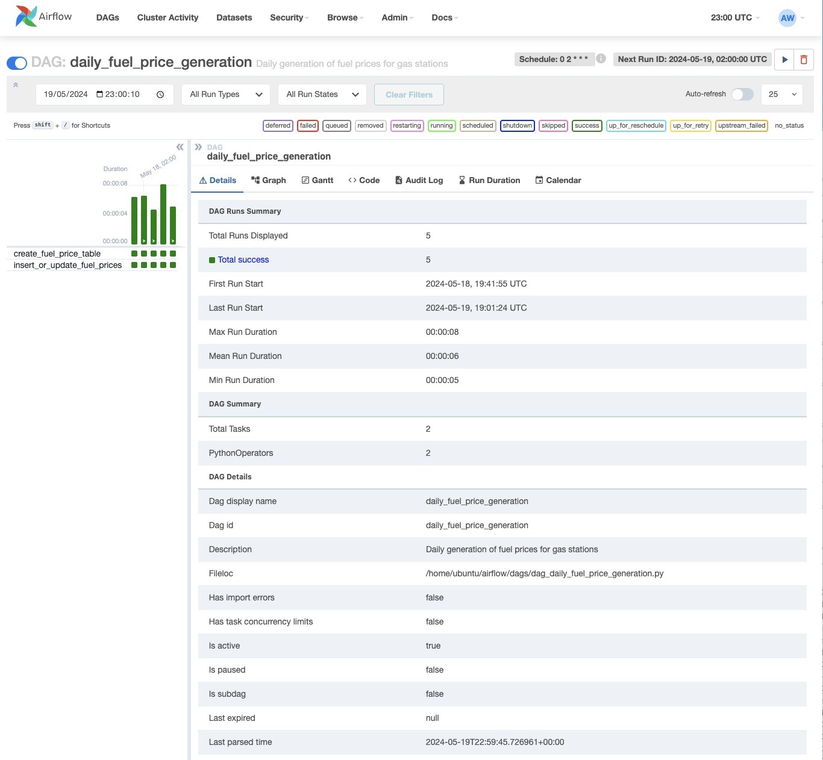
Data Pipline
Data Collection
Relational Database
Daily Updated
API

Slide 10
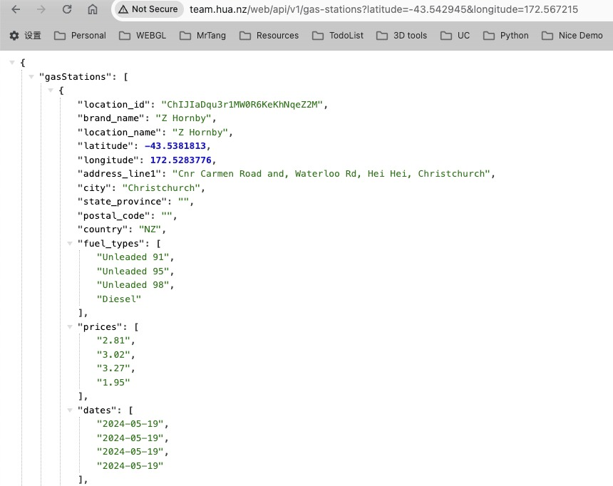
Data Pipline
Data Collection
Relational Database
Daily Updated
API

